Slide 1


Slide 2
SURAH HUJRAT

Slide 3
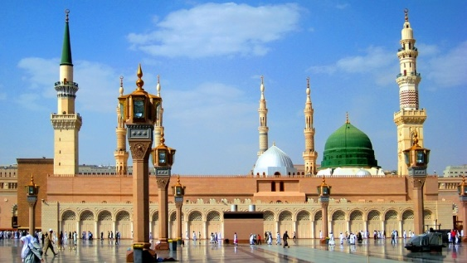
SOME INFORMATION ABOUT SURAH HUJRAT:
Surah Hujrat is the 49 Surah of the Quran.
Surah Hujrat contains 2 Rukus.
Surah Hujrat contains 18 verses.
Surah Hujrat is a Madani Surah which means that it was revealed after the migration to Madina.
Al-Hujrat means the "The Chambers"

Slide 4

SHAN-E-NUZOOL:
When Hazrat Muhammad (S.A.W) soujern from macca to madina that was the time when preaching of Islam was on peek, Islamic state coming to being that is why this surah revealed and in this surah we have been commanded by certain rules and regulation. This surah tell us the ways by which we have to live in Islam.

Slide 5
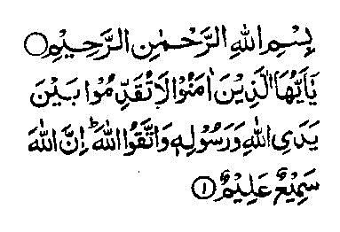
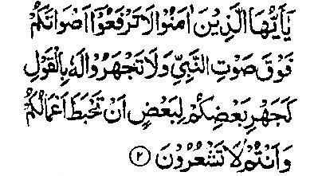
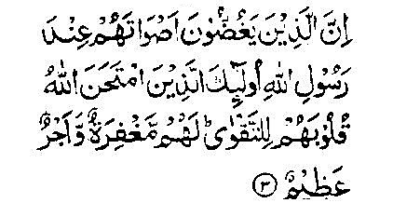
TRANSLATION OF AYATS:
TRANSLATION:
1) Ye who believe! Be not forward in the presence of Allah and his Messenger, and keep your duty to Allah. Lo! Allah is Hearer, Knower.
TRANSLATION:
2) Ye who believe! Lift not up your voice above the voice of the prophet, nor shout when speaking to him as ye shout one to another, lest your work be rendered vain while ye perceive not.
TRANSLATION:
in the presence of Allah's Messenger, - their hearts has Allah tested for piety: for them is Forgiveness and a great Reward.

Slide 6
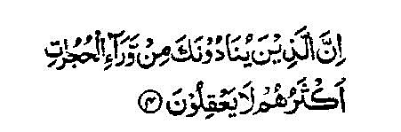
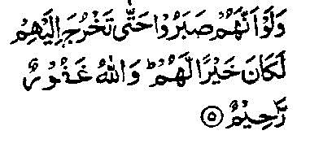
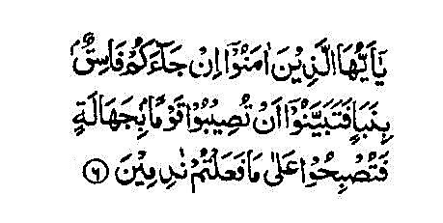
TRANSLATION: Lo! Those who call thee from behind the private apartments, most of them have no sense.
TRANSLATION: And if they had had patience till thou comes forth unto them it had been better for them. And Allah is forgiving, merciful.
TRANSLATION:
And if they had had patience till thou comes forth unto them it had been better for them. And Allah is forgiving, merciful.

Slide 7
The goal of Surah Hujrat is to educate upon a series of life-giving commandments of Akhlaq (Ethics and Morality) and social interaction which (if put into practice), would lead an ideal civilization. These in turn could create and cultivate and cultivate a pure that is far removed from all sorts of blameworthy moral traits.

Slide 8
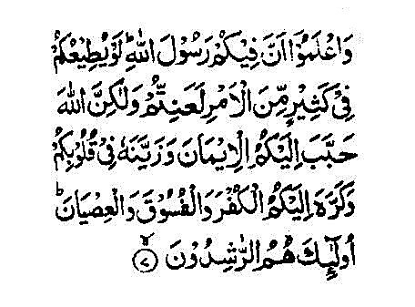
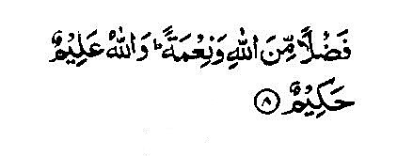
TRANSLATION: 6) ye who believe! If an evil doer bring you tiding, verify it, lest ye smite some folk in ignorance and afterward repent of what ye did.
TRANSLATION:
7) and know that the messenger of Allah is among you. If he were to obey you much if the government, ye would surely be in trouble; but Allah hath endeared the faith to you and hath beautified It in your hearts, and hath made disbelief and lewdness and rebellion hateful unto you, such are they who are rightly guided.
TRANSLATION: 8) (it is) a bounty and grace from Allah and Allah is knower, wise.

Slide 9
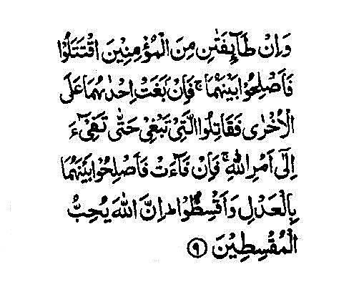
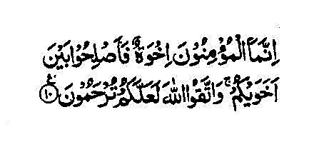
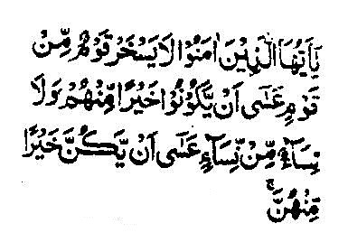
Translation: 9) And if two parties of believers fall into fighting, then make peace between them . and if one party of them doeth wrong to the other, fight ye that doeth wrong till it return unto the ordinance of Allah; then, if, it return, make peace between them justly, and act equitably. Lo! Allah loveth the equitable.
TRANSLATION: 10) The believers are naught else then brothers. Therefore make peace between your brethren and observe your duty to Allah that haply ye may obtain mercy.
TRANSLATION: 11) O ye who believe! Lo Allah not a folk deride a folk who may be batter then they (are), nor let women (deride) women who may be batter then they are.

Slide 10
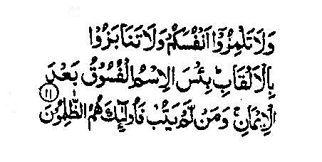
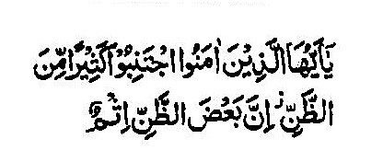
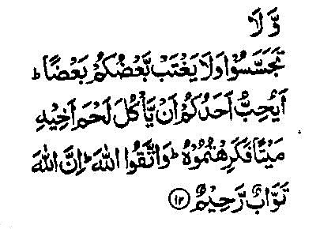
TRANSLATION: 11) And do not taunt your people and tease not neither, nor insult one another by nicknames Bad is the name of lewdness after faith. And whose turned not in repentance, such are evil-doers.
TRANSLATION: 12) O ye believe! Shun much suspicion; for lo! Some suspicion is a crime. And spy not.
TRANSLATION: 12) Neither backbite one another, would one of you love to eat the flesh of his dead brother? Ye abhor that (so abhor the other)! And keep your duty (to Allah). Lo! Allah is relenting, Merciful.

Slide 11
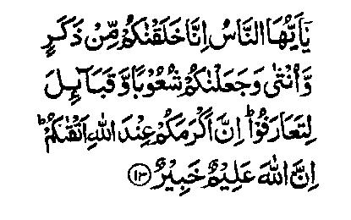
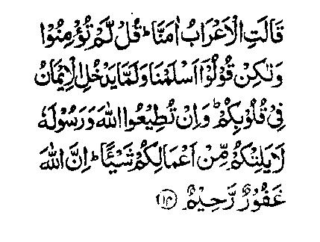
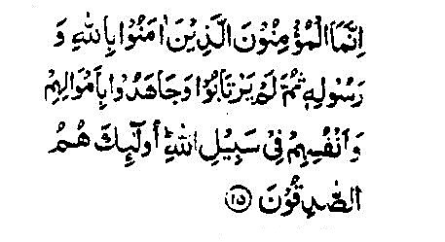
TRANSLATION:
13) O mankind Lo! we have created you male and female, and have made you nations and tribes that you may know one another, Lo! The noblest of you, in the sight of Allah, is the best in conduct, Lo! Allah is knower, Aware.
TRANSLATION:
14) The wandering Arabs say: We believe. Say (unto them O Muhammad): Ye believe not, but rather say “we submit”, for the faith hath not yet, if ye obey Allah and his messenger, he will not withhold from you aught of (the reward of) your deeds. Lo! Allah so forgiving, merciful.
TRANSLATION: 15) The (true) believers are those only who believe in Allah and his messenger and afterward doubt not, but strive with their wealth and their lives for cause of Allah. Such are sincere.

Slide 12
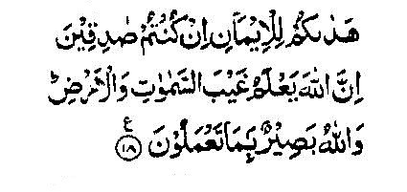
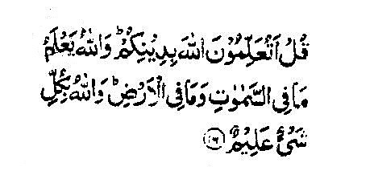
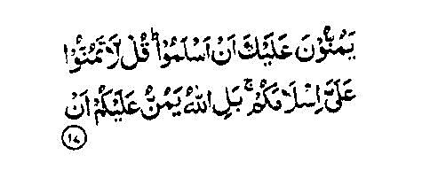
TRANSLATION: 16) say (unto them,O muhammad PBUH): would ye teach Allah your religion, when Allah knoweth all that is in the heavens and all that is in the earth, and Allah is aware of all things?
What do you teach / What do you take pride on.
TRANSLATION: 17) They make it a favour unto thee (Muhammad (PBUH)) that they have surren dered (unto Him), Say: Deem not your Surrender a favour unto me: nay, but Allah doth confer a favour on you, in as much as He hath led you to the Faith, if ye are earnest.
They count as favour to you do not count as favor to me.
TRANSLATION: 18) Lo! Allah knoweth the unseen of the heavens and the earth. And Allah is Seer of what ye do.
The things from the heavens hidden from the eyes of men. He who sees best.

Slide 13

What we have learned from Ayats given Above:
RESPECT (Ayah 1-5):
In the first five verses they have been the manners they should observe with regard to Allah and his Messenger. Muslims should not be arrogant.
They should have respect for Allah and his messenger.
Allah is most forgiving for those who forget.

Slide 14

Backbiting (Ayah 6-10)
Mocking and taunting each other, calling others by nicknames, creating suspecios, praying into other people’s affairs and back biting are the evils which are not only sins in themselves but they also corrupt society.
Allah has forbidden these as unlawful.

Slide 15

Negative Thoughts (Ayah 11-13))
Do not insult one another not backbite or spy.
The feeling of superiority and looking down upon others has filled the world with injustice and tyranny.
Allah in a brief verse has cut at the root of this evil by stating that all man are descendants of the same one pair.

Slide 16
Levels of Faith (Ayah 14-18)
The people have been told that the real thing is not the verbal profession of the faith but to believe in Allah and his messenger truly,to obey them in practical life and to exert sincerely with one’s self and wealth in the cause of Allah.
True believers are only those who adopt this attitude.

Slide 17
First Injunction:
Be not forward in presence of ALLAH and his messenger.
Your voices above the voice of the Prophet.
2nd Injunction:-
illustrates the difference patience.
12 INJUNCTION:-

Slide 18
3rd Injunction:-
ill mannered & impolite
4th Injunction:-
Don’t heed, what is said by evil doers.
5th Injunction:-
Interest of a good society.

Slide 19
6th Injunction:-
Violator/sinner thing fondly checked.
7th Command:-
“TO TAUNT”
8th Command:-
Don’t Tease

Slide 20
9th Order:-
DOUBT
SIN
10th Order:-
Suspicion
11th Injunction:-
Backbiting
12th Injunction:-
(GOD FEARING)

Slide 21
Conclusion:
In conclusion, this surah talks about how to act civilized; to treat others with respect, to cease bickering, to negate negative thoughts, and to sincerely believe in Allah, not just verbally profess it.

Slide 22


